Slide 1
Simon App with Hardware
Bobby Eshleman
Chris Clark

Slide 2
Project Deliverables
Web application (sqlite3, Django, HTML, CSS, Python, Javascript)
Android application with hardware integration for Simon memory game
Hardware conversation with android app to get user info and data
Mobile Application for users to play the game using the hardware peripheral

Slide 3
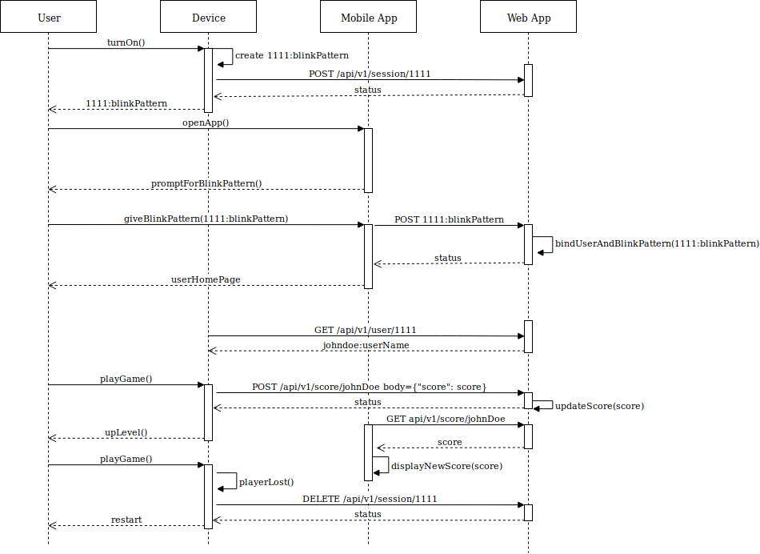
Process

Slide 4
Challenges
Hardware interrupt challenges within the ESP32 environment (interrupts are limited)
Deploying webapp to the cloud
Enforcing CSRF
Learning Javacript for the backend

Slide 5
Future Possibilities
Moving to 6 buttons instead of 4
Multiple users for the app for head to head competition between friends
Implementing Security of user information

